Slide 1

Industry 5.0

Slide 2

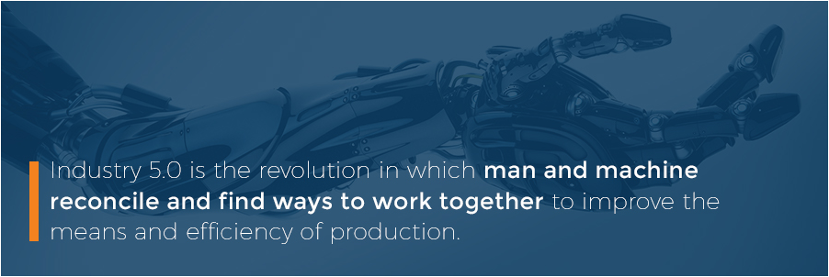
INDUSTRY 5.0

Slide 3
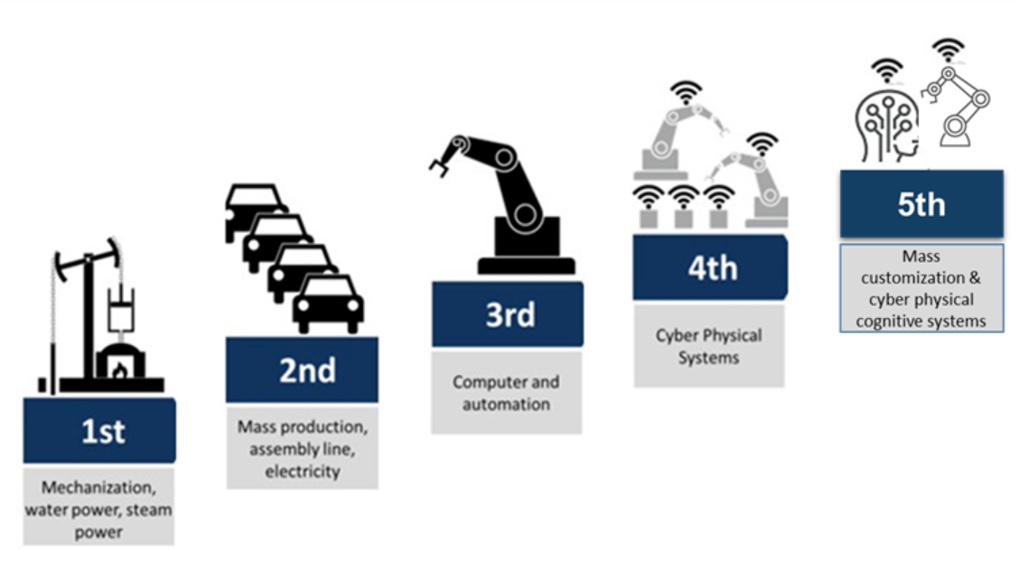
EVOLUTION

Slide 4
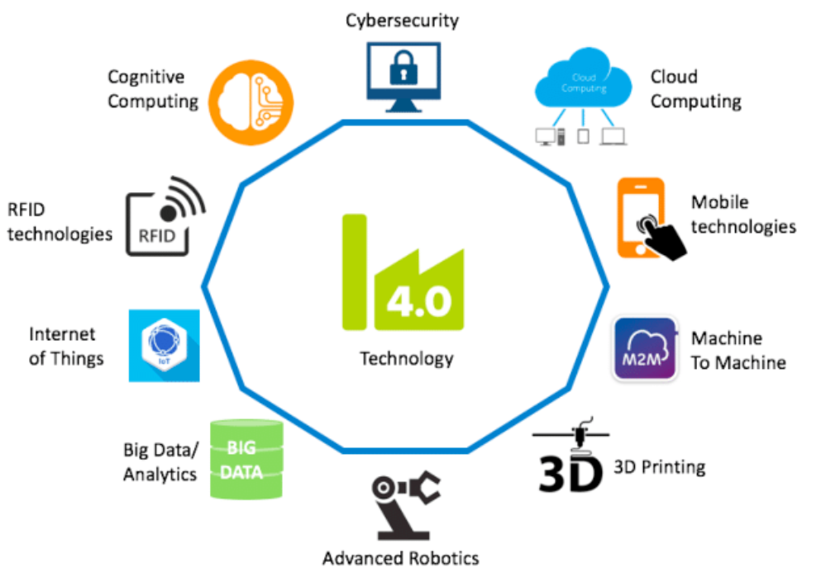
CURRENT SCENARIO
IOT
RFID
Cloud Computing
Robotics
Cognitive Computing

Slide 5
PRINCIPLES of 4.0
Interoperability
Information transparency
Technical assistance.
Decentralized decisions

Slide 6
Advantages of 4.0
Scalability - With automation, manufacturers will have a new found ability to transfer staff to different departments, away from the physically dangerous areas of production.
Control and Visibility - They help to improve collaboration by connecting factories and personnel across different regions via cloud servers. Industry 4.0 allows for enhanced visibility across all links in the manufacturing process.
Customer Satisfaction - Industry 4.0 will aid in the ability of manufacturers to collaborate with suppliers and customers alike.
Customization - When it comes to the repair and correction of faulty designs, cognitive computing could handle the necessary modifications.

Slide 7
OBSTACLES
Reliability issues with machine-to-machine (M2) communication, which hasn’t fully arrived at the levels of performance and stability envisioned by Industry 4.0 proponents.
IT security concerns, which become even more pressing as older, long-unused facilities are brought into the fold.
Fear of IT glitches — until artificial intelligence has long proven itself across vast IoT infrastructures, the possibility of costly mishaps leaves many manufacturers skeptical.
Insufficient skill-sets for the implementation of Industry 4.0 among factory engineers.
Fear that Industry 4.0, once fully implemented, could spark mass layoffs across the industrial sector, leaving many low-educated factory workers jobless.

Slide 8

Industry 4.0 Today, Industry 5.0 Tomorrow
As technological innovations become ever more rapid, revolutions could ultimately follow one another in quick succession over the next 10 years and beyond.
Noting the speed of these developments, it is only natural that talk of a fifth revolution would quickly follow the fourth.

Slide 9

THANK YOU!!

